Slide 1
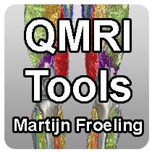










QMRITools
a versatile toolbox for quantitative magnetic resonance imaging (MRI) analysis
www.qmritools.com m.froeling@gmail.com www.muscleatlas.org ISMRM 2023 - June 7th

Slide 2
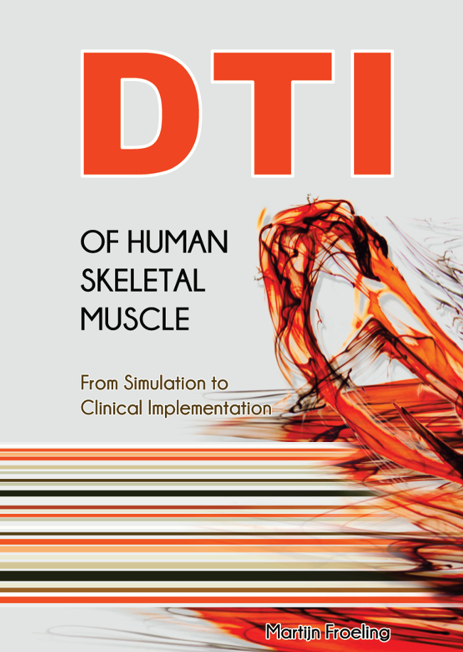
How it started: start small time does the rest
Collecting functions used in MSc and PhD (DTITools: 2009-2012)
Moving beyond DTI and muscle (multiple toolboxes: 2012-2016)
Merging into one and first GitHub page created (Release v1.3.1-v1.9: 2016-2018)
Renaming to QMRITools and first GitHub website (v2.0 - mfroeling.github.io/qmritools - QMRITools: 2018)
Publised in Journal of Open Source Software (DOI: 10.21105/joss.01204: 2019)
Extended to more elaborate Jekyll website (www.qmritools.com: 2021)
PhD thesis Martijn Froeling 2012, Eindhoven, The Netherlands

Slide 3
How it grew: for each project what can be generalized?
Philosophy:
Separate functionality from project based scripting/pipelines
No graphical user interfaces
When prototyping:
Comment code
Only optimize if used often
When functionality is added:
Write documentation per function
Write usage example
List of toolboxes:
CardiacTools
CoilTools
DenoiseTools
DixonTools
ElastixTools
FasciculationTools
GeneralTools
GradientTools
ImportTools
IVIMTools
JcouplingTools
LoggingTools
MaskingTools
VisteTools
MuscleBidsTools
NiftiTools
PhysiologyTools
PlottingTools
ProcessingTools
ReconstructionTools
RelaxometryTools
SimulationTools
SpectroTools
TaggingTools
TensorTools
TractographyTools

Slide 4
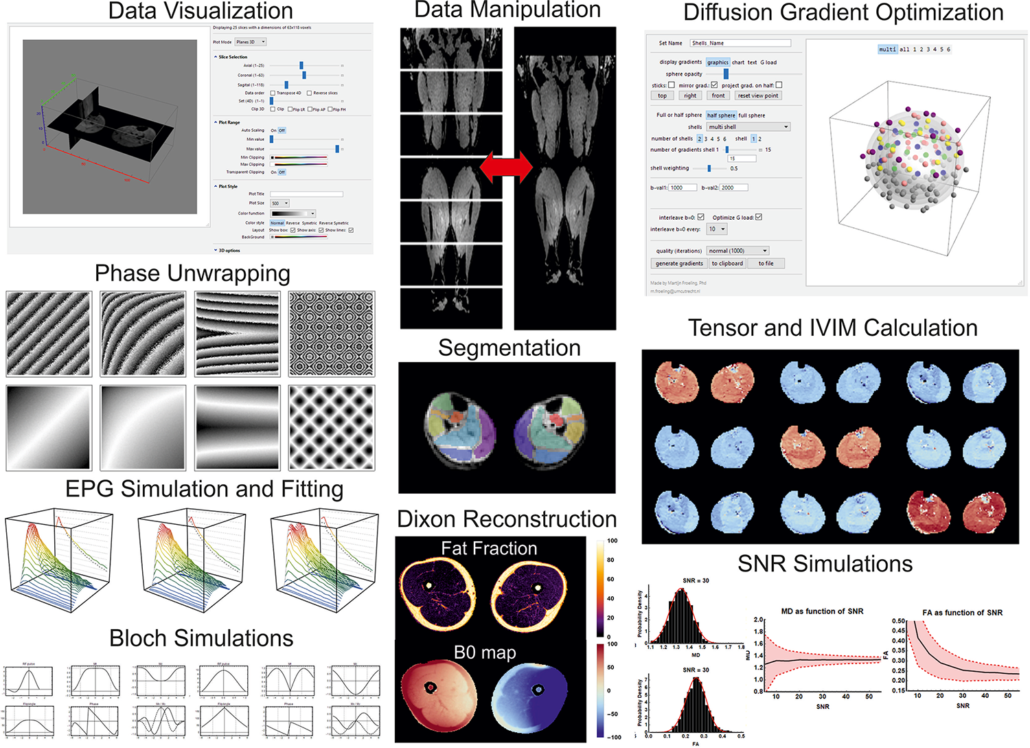
Current status: still grows every day
400+ function
200+ options
800+ documentation pages
100+ usage examples
50+ publications
Updating is part of workflow
28 releases

Slide 5
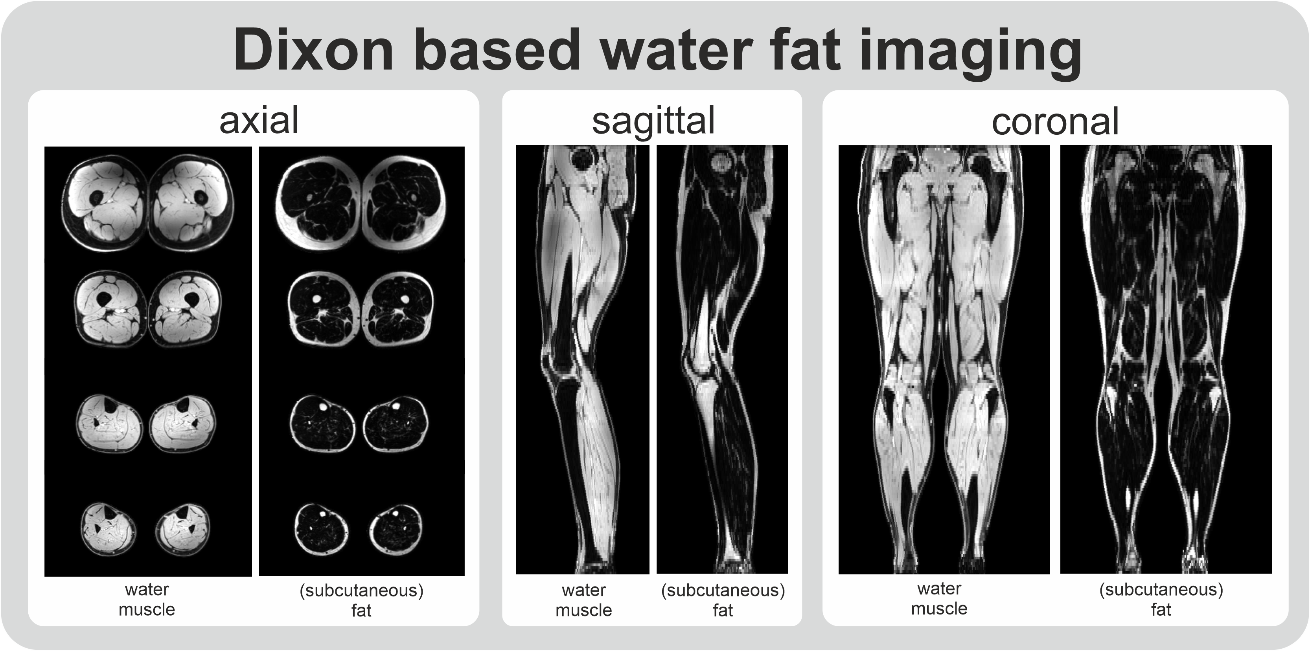
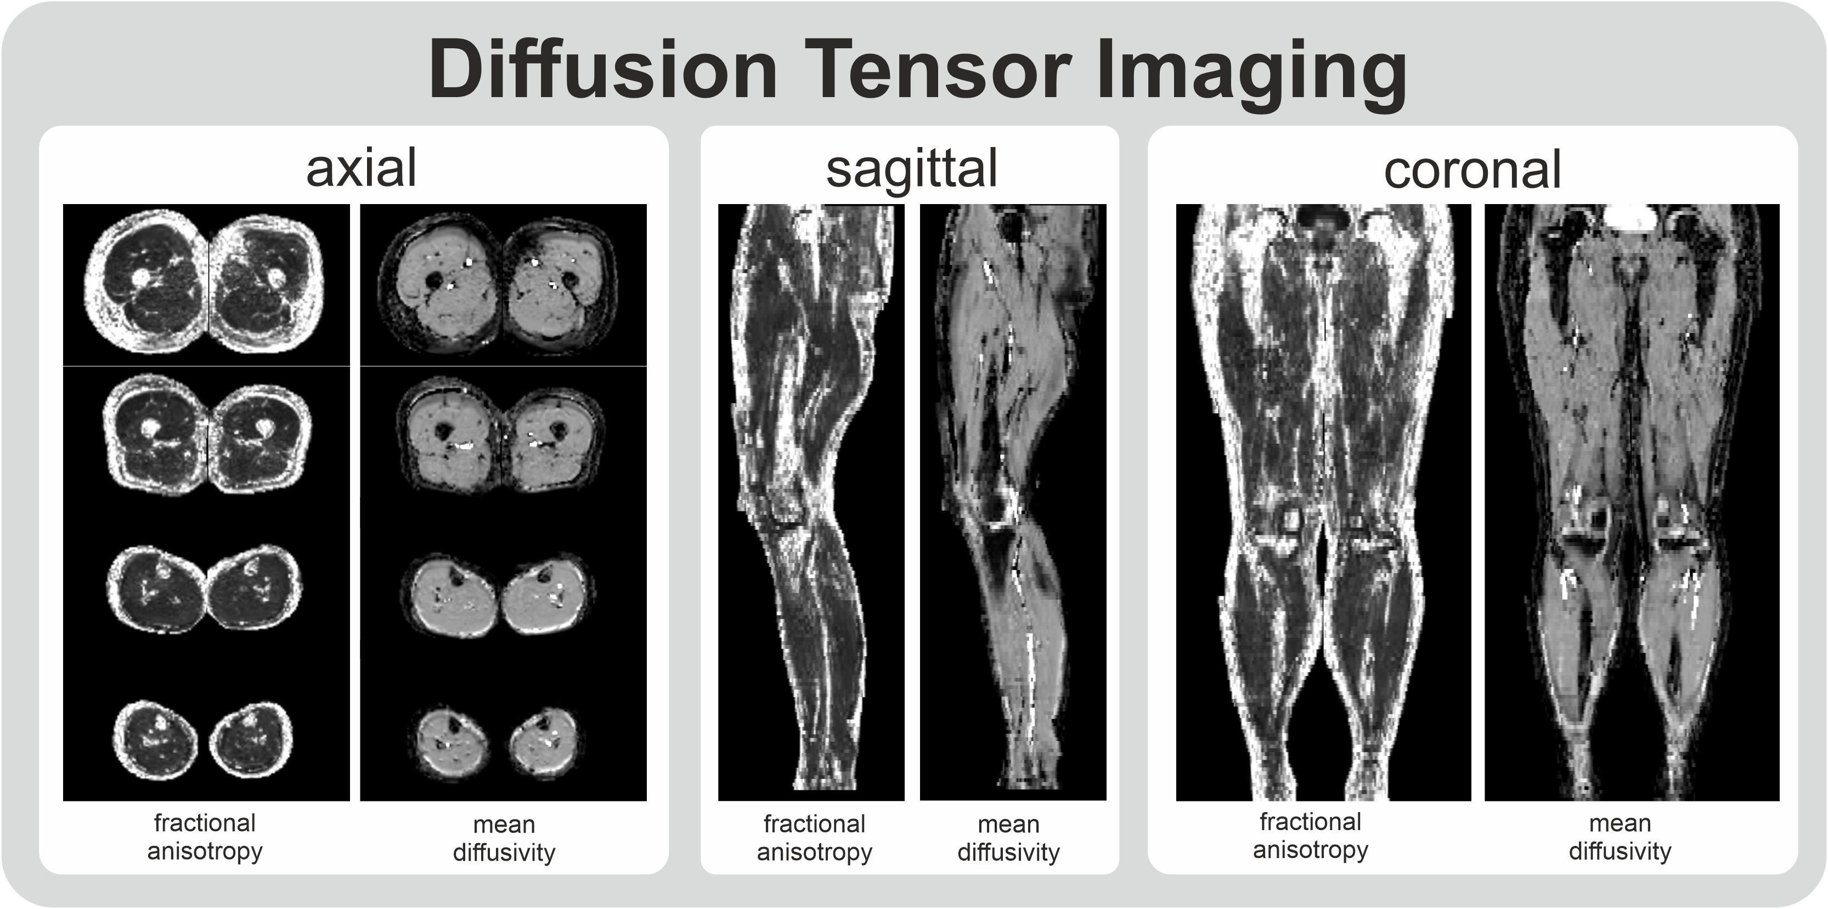
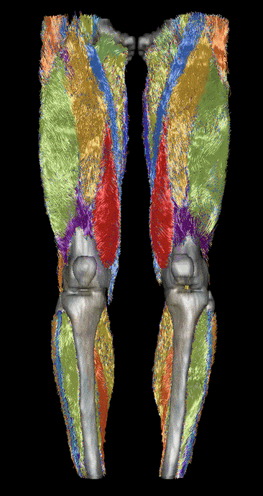
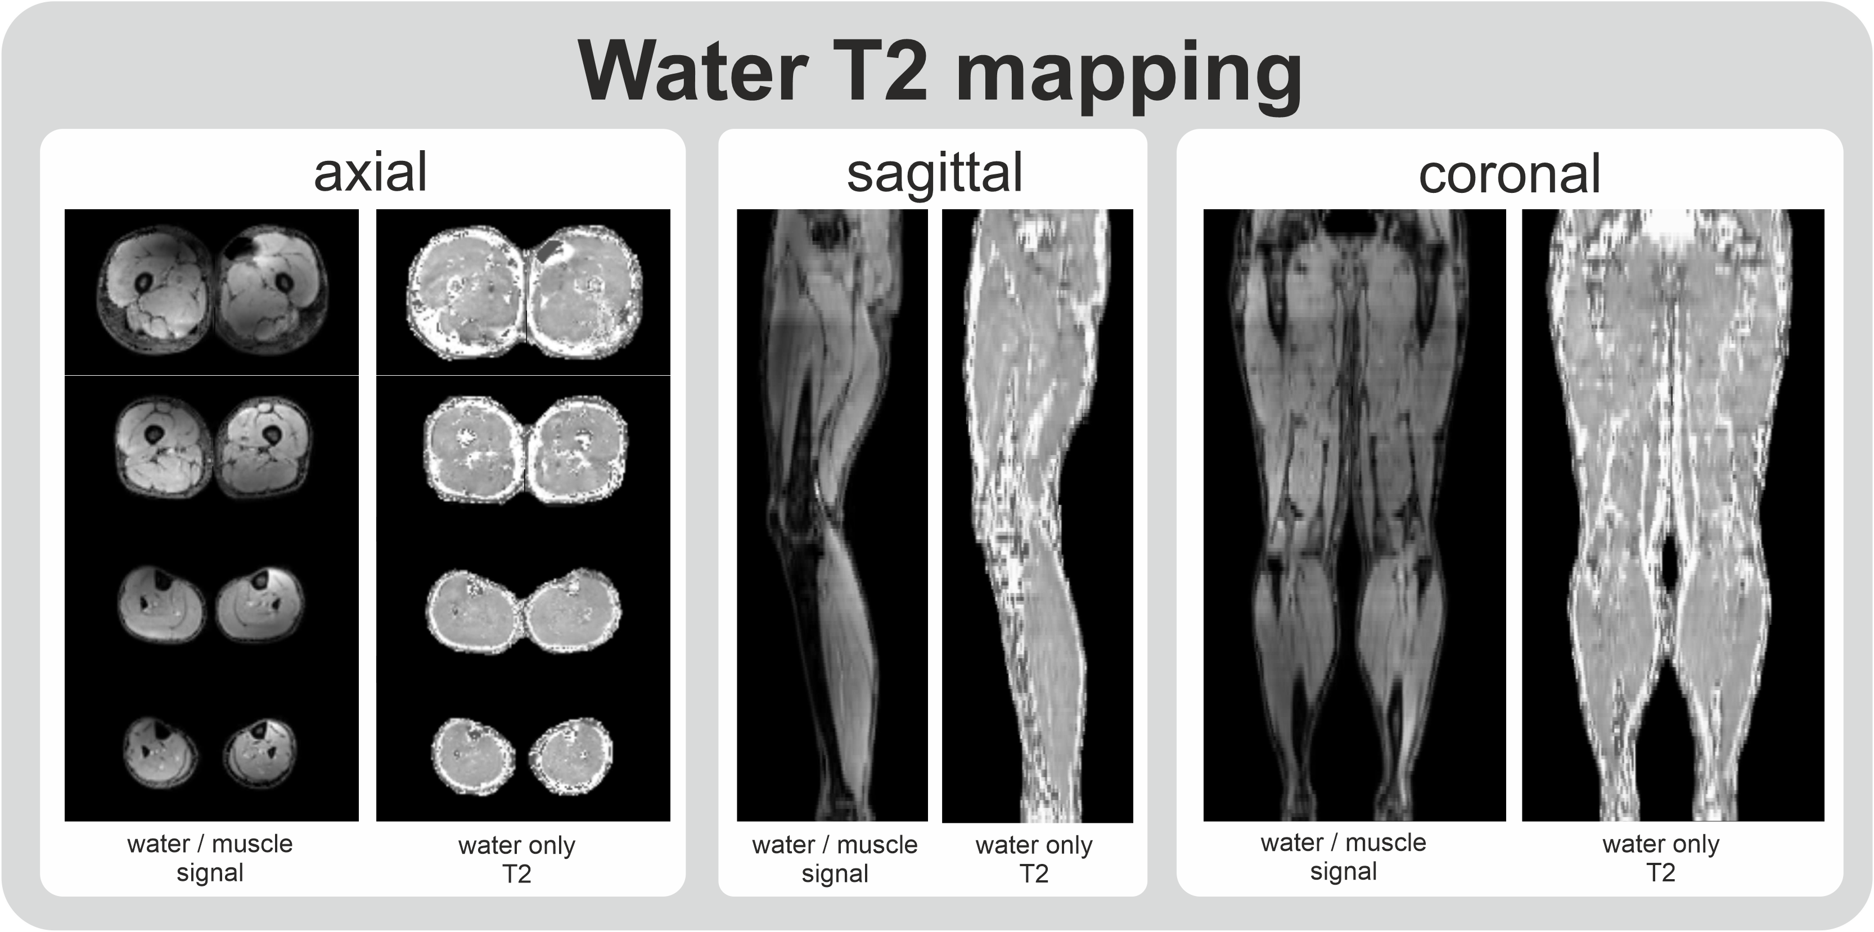
Where will it go: based on projects I work on
The motion study (www.muscle-atlas.org)
“The Motion Study aims to gather data from 160 healthy individuals aged 15 to 65 years, using a combination of bilateral quantitative MRI scans of the full legs and force measurements. The study has three parts: two questionnaires, an MRI scan, and muscle strength measurements.”

Slide 6
